Slide 1
Cloud Hosting, Development, and Security
Mike Nescot, Director of Cloud and DevOps Solutions, JBS International

Slide 2
Agenda
Cloud Computing Basics
Government Adoption
Cloud Providers and Services
Demos

Slide 3

Notes:
10/10/16
3
3

Slide 4
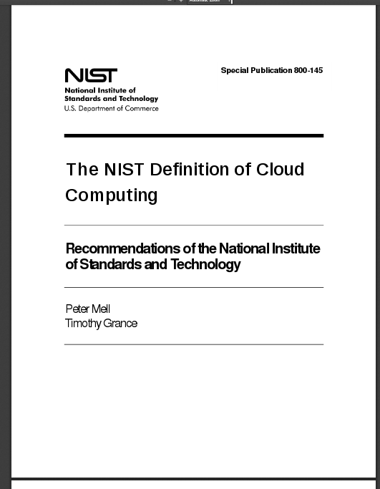

Slide 5
Cloud Computing: Essential Characteristics
On-demand self-service: Consumer can unilaterally provision computing capabilities such as server time and network storage, as needed automatically without requiring human interaction with each service provider.
Broad network access: Capabilities are available over the network and accessed through standard mechanisms that promote use by heterogeneous thin or thick client platforms (e.g., mobile phones, tablets, laptops, and workstations).
Notes:
10/10/16
5
5

Slide 6
Cloud Computing: Essential Characteristics
Resource pooling: Provider’s computing resources are pooled to serve multiple consumers using a multi-tenant model, with different physical and virtual resources dynamically assigned and reassigned according to consumer demand. There is a sense of location independence… Examples of resources include storage, processing, memory, and network bandwidth.
Rapid elasticity: Capabilities can be elastically provisioned and released, in some cases automatically, to scale rapidly outward and inward commensurate with demand. Capabilities available for provisioning appear to be unlimited.
Notes:
10/10/16
6
6

Slide 7
Cloud Computing: Essential Characteristics
Measured service. Cloud systems automatically control and optimize resource use by leveraging a metering capability at some level of abstraction appropriate to the type of service (e.g., storage, processing, bandwidth, and active user accounts). Resource usage can be monitored, controlled, and reported providing transparency for both the provider and consumer of the utilized service.
Notes:
10/10/16
7
7

Slide 8
Cloud Computing: Service Models
Infrastructure as a Service (IaaS). The capability provided to the consumer is to provision processing, storage, networks, and other fundamental computing resources where the consumer is able to deploy and run arbitrary software, which can include operating systems and applications. The consumer does not manage or control the underlying cloud infrastructure but has control over operating systems, storage, and deployed applications; and possibly limited control of select networking components (e.g., host firewalls).
Notes:
10/10/16
8
8

Slide 9
NIST Definition: Service Models
Platform as a Service (PaaS). The capability provided to the consumer is to deploy onto the cloud infrastructure consumer-created or acquired applications created using programming languages, libraries, services, and tools supported by the provider.The consumer does not manage or control the underlying cloud infrastructure including network, servers, operating systems, or storage, but has control over the deployed applications and possibly configuration settings for the application-hosting environment.
Notes:
10/10/16
9
9

Slide 10
NIST Definition: Service Models
Software as a Service (SaaS). The capability provided to the consumer is to use the provider’s applications running on a cloud infrastructure. The applications are accessible from various client devices through either a thin client interface, such as a web browser (e.g.,web-based email), or a program interface. The consumer does not manage or control the underlying cloud infrastructure including network, servers, operating systems, storage, or even individual application capabilities, with the possible exception of limited user specific application configuration settings
Notes:
10/10/16
10
10

Slide 11
NIST Definition: Deployment Models
Private cloud. The cloud infrastructure is provisioned for exclusive use by a single organization comprising multiple consumers (e.g., business units). It may be owned, managed, and operated by the organization, a third party, or some combination of them, and it may exist on or off premises.
Community cloud. The cloud infrastructure is provisioned for exclusive use by a specific community of consumers from organizations that have shared concerns (e.g., mission, security requirements, policy, and compliance considerations). It may be owned, managed, and operated by one or more of the organizations in the community, a third party, or some combination of them, and it may exist on or off premises.
Notes:
10/10/16
11
11

Slide 12
NIST Definition: Deployment Models
Public cloud. The cloud infrastructure is provisioned for open use by the general public. It may be owned, managed, and operated by a business, academic, or government organization, or some combination of them. It exists on the premises of the cloud provider.
Hybrid cloud. The cloud infrastructure is a composition of two or more distinct cloud infrastructures (private, community, or public) that remain unique entities, but are bound together by standardized or proprietary technology that enables data and application portability (e.g., cloud bursting for load balancing between clouds).
Notes:
10/10/16
12
12

Slide 13
Hybrid Cloud
On Premise Connectivity (VPC)
On Premise Resources (AD Server, archive storage, logs)
Multi-Cloud Resources (Azure, Google BigQuery, IBM Watson)

Slide 14
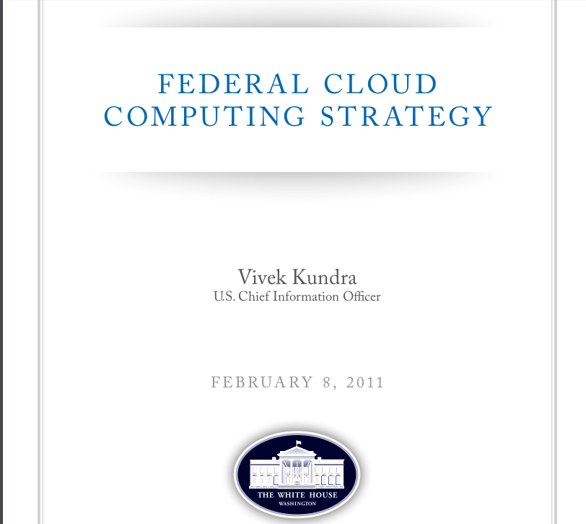
Notes:
10/10/16
14
14

Slide 15
Cloud First Policy
The Federal Government’s current Information Technology (IT) environment is characterized by low asset utilization, a fragmented demand for resources, duplicative systems, environments which are difficult to manage, and long procurement lead times. These inefficiencies negatively impact the Federal Government’s ability to serve the American public.
Cloud computing has the potential to play a major part in addressing these inefficiencies and improving government service delivery. The cloud computing model can significantly help agencies grappling with the need to provide highly reliable, innovative services quickly despite resource constraints
..
Notes:
10/10/16
15
15

Slide 16
Cloud First Policy
Commercial service providers are expanding their available cloud offerings to include the entire traditional IT stack of hardware and software infrastructure, middleware platforms, application system components, software services, and turnkey applications.
The private sector has taken advantage of these technologies to improve resource utilization, increase service responsiveness, and accrue meaningful benefits in efficiency, agility, and innovation.
Notes:
10/10/16
16
16

Slide 17
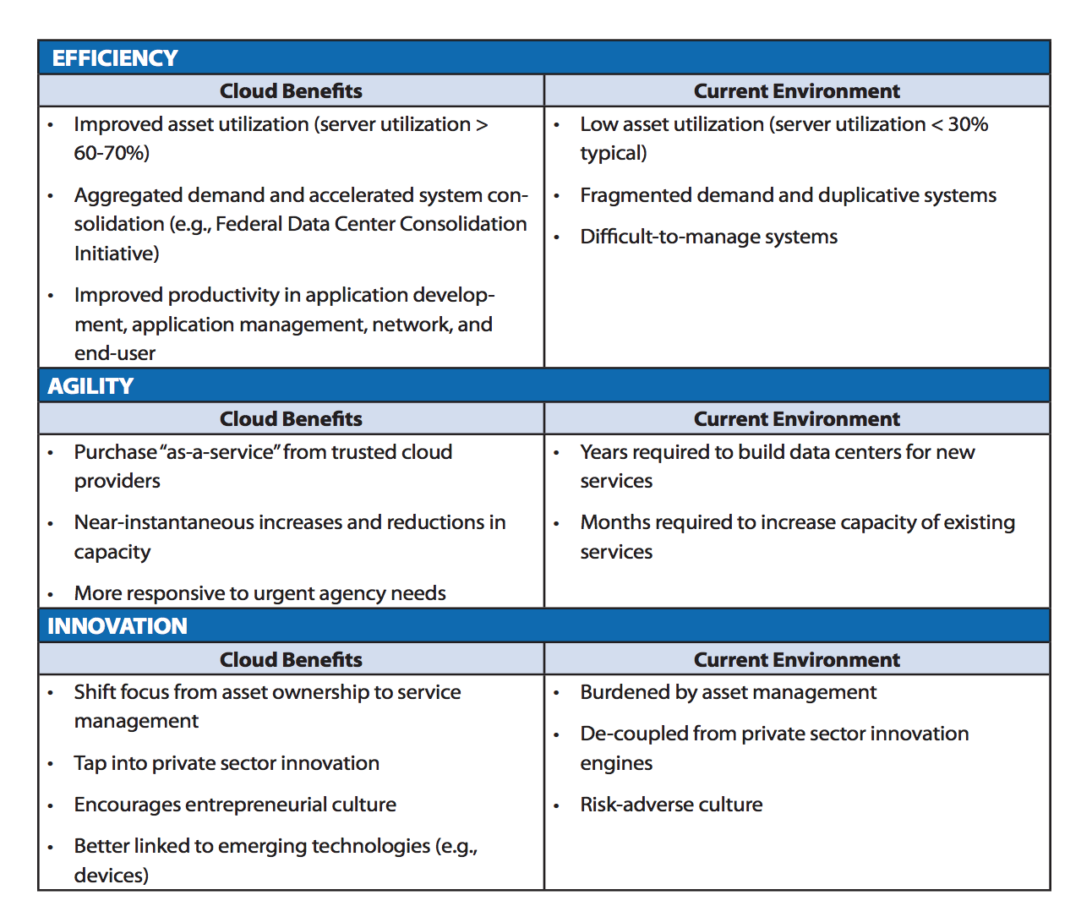

Slide 18
FedRAMP Cloud Service Provider Shopping Guide
https://marketplace.fedramp.gov

Slide 19
FedRAMP Authorization Types: Cloud Service Providers
JAB (Joint Authorization Board): CSP has undergone a technical review by the FedRAMP Project Management Office (PMO) and has been assessed by a FedRAMP accredited third-party assessor (3PAO), representatives from the Department of Homeland Security (DHS), Department of Defense (DoD), and the General Services Administration (GSA).
Agency: CSP has worked with that specific agency to develop a cloud platform that meets all agency security controls. The FedRAMP PMO has performed an initial review of the cloud documentation before awarding a P-ATO.
CSP: CSP has worked with that specific agency to develop a cloud platform that meets all agency security controls. The FedRAMP PMO has performed an initial review of the cloud documentation before awarding a P-ATO.

Slide 20
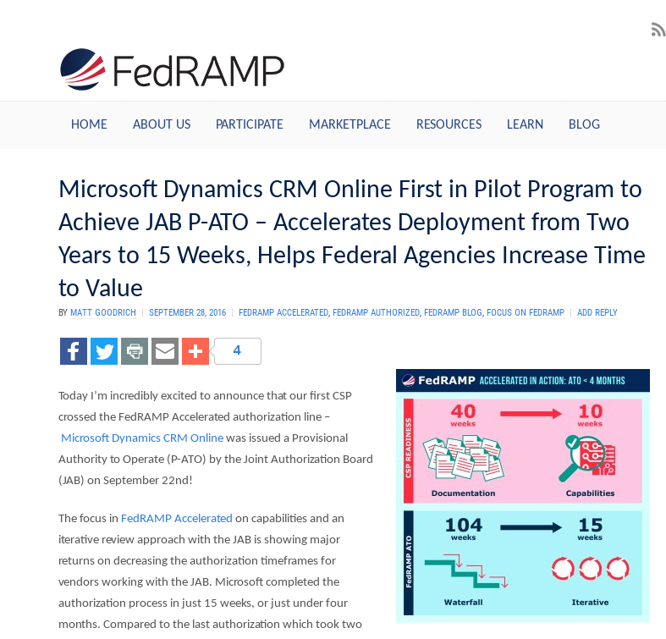
Notes:
10/10/16
20
20

Slide 21
Regulatory Compliance
FedRAMP
FISMA
FERPA (Education)
HIPPA (Health)
DOD Cloud Security Requirements Guide (Defense)
CJIS
Notes:
10/10/16
21
21

Slide 22
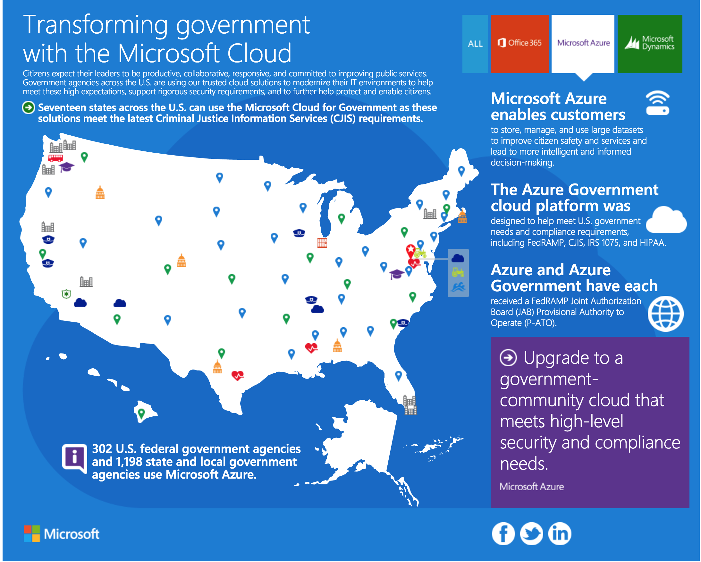

Slide 23
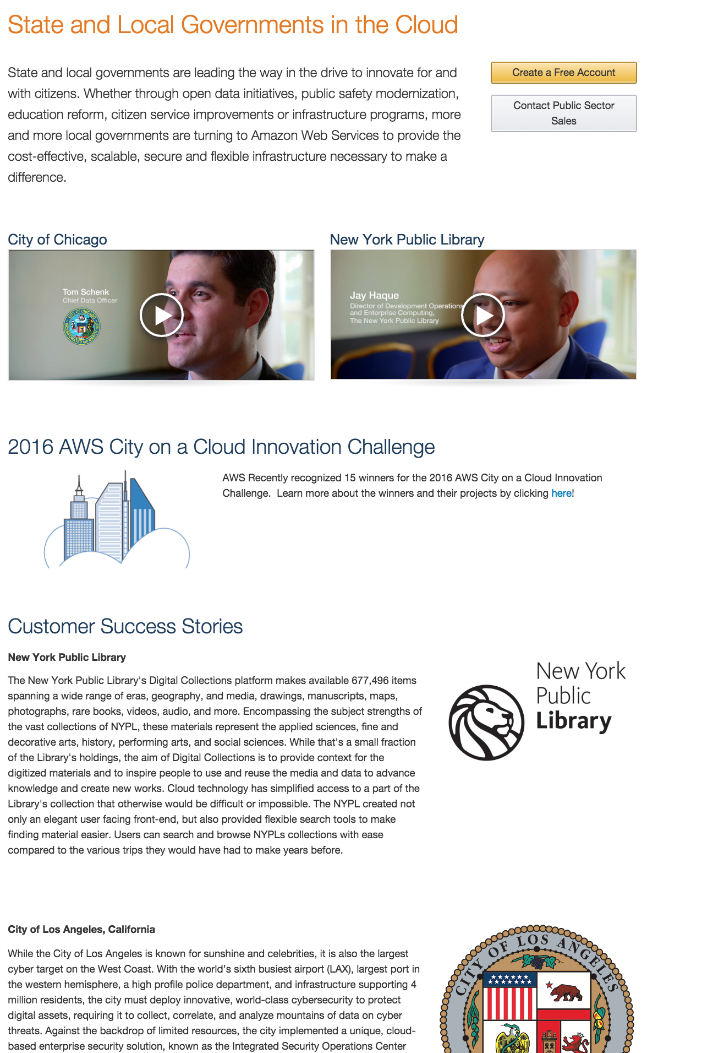

Slide 24
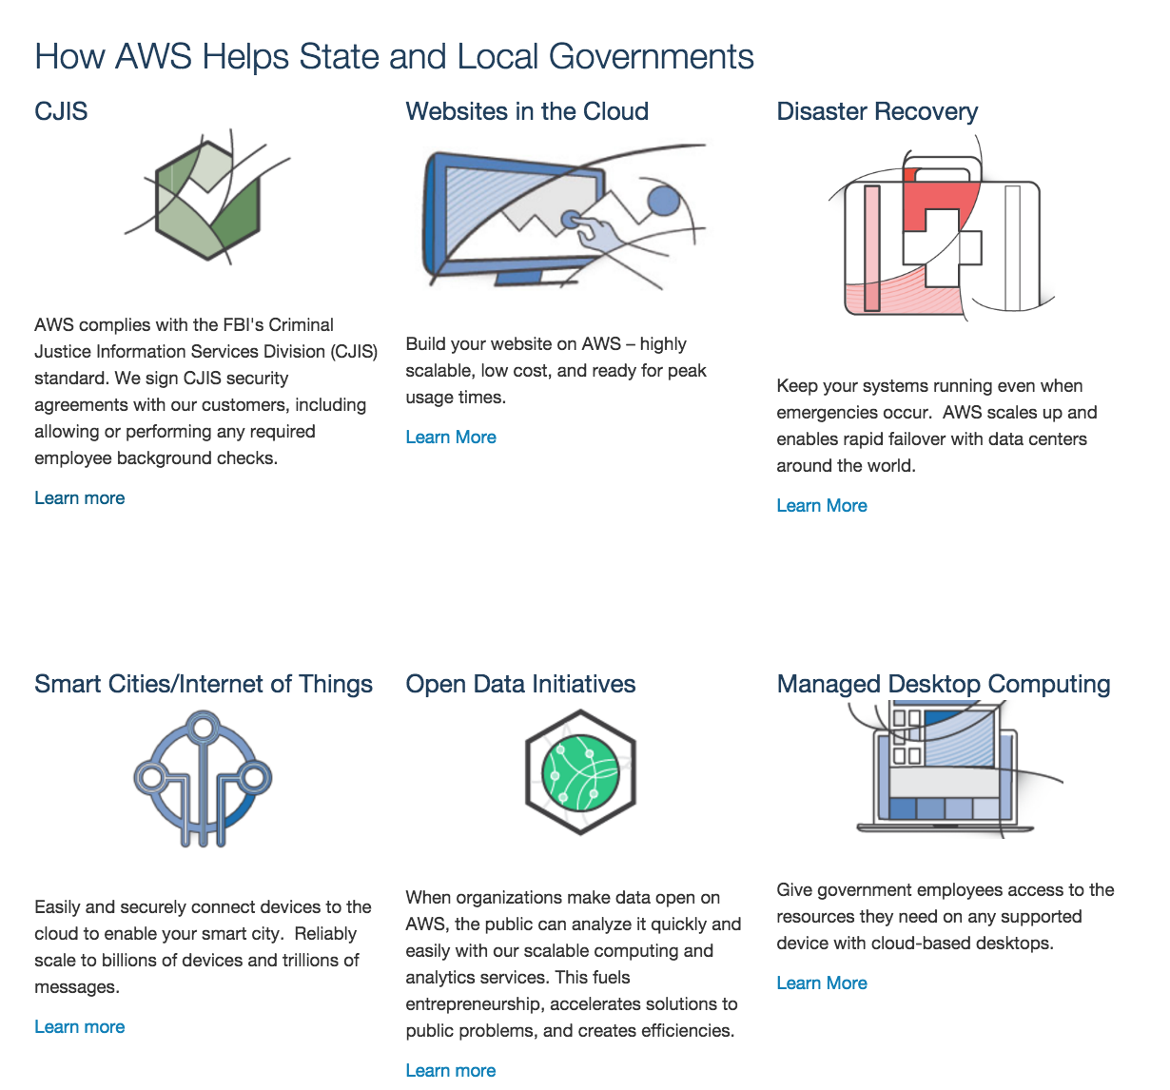

Slide 25
IaaS Big Three
Amazon Web Services (AWS)
Microsoft Azure
Google Cloud Platform (GCP)

Slide 26
IaaS Government
Amazon Web Services (AWS)
Microsoft Azure
IBM
HPE
Verizon

Slide 27
Cloud Resources Comparison
http://cloudcomparison.rightscale.com
Notes:
10/10/16
27
27

Slide 28
Core IaaS Services
Compute: VMs (Autoscaling)
Networking
Security
Storage (File, Object, Block)
Database
Identity/Authorization

Slide 29
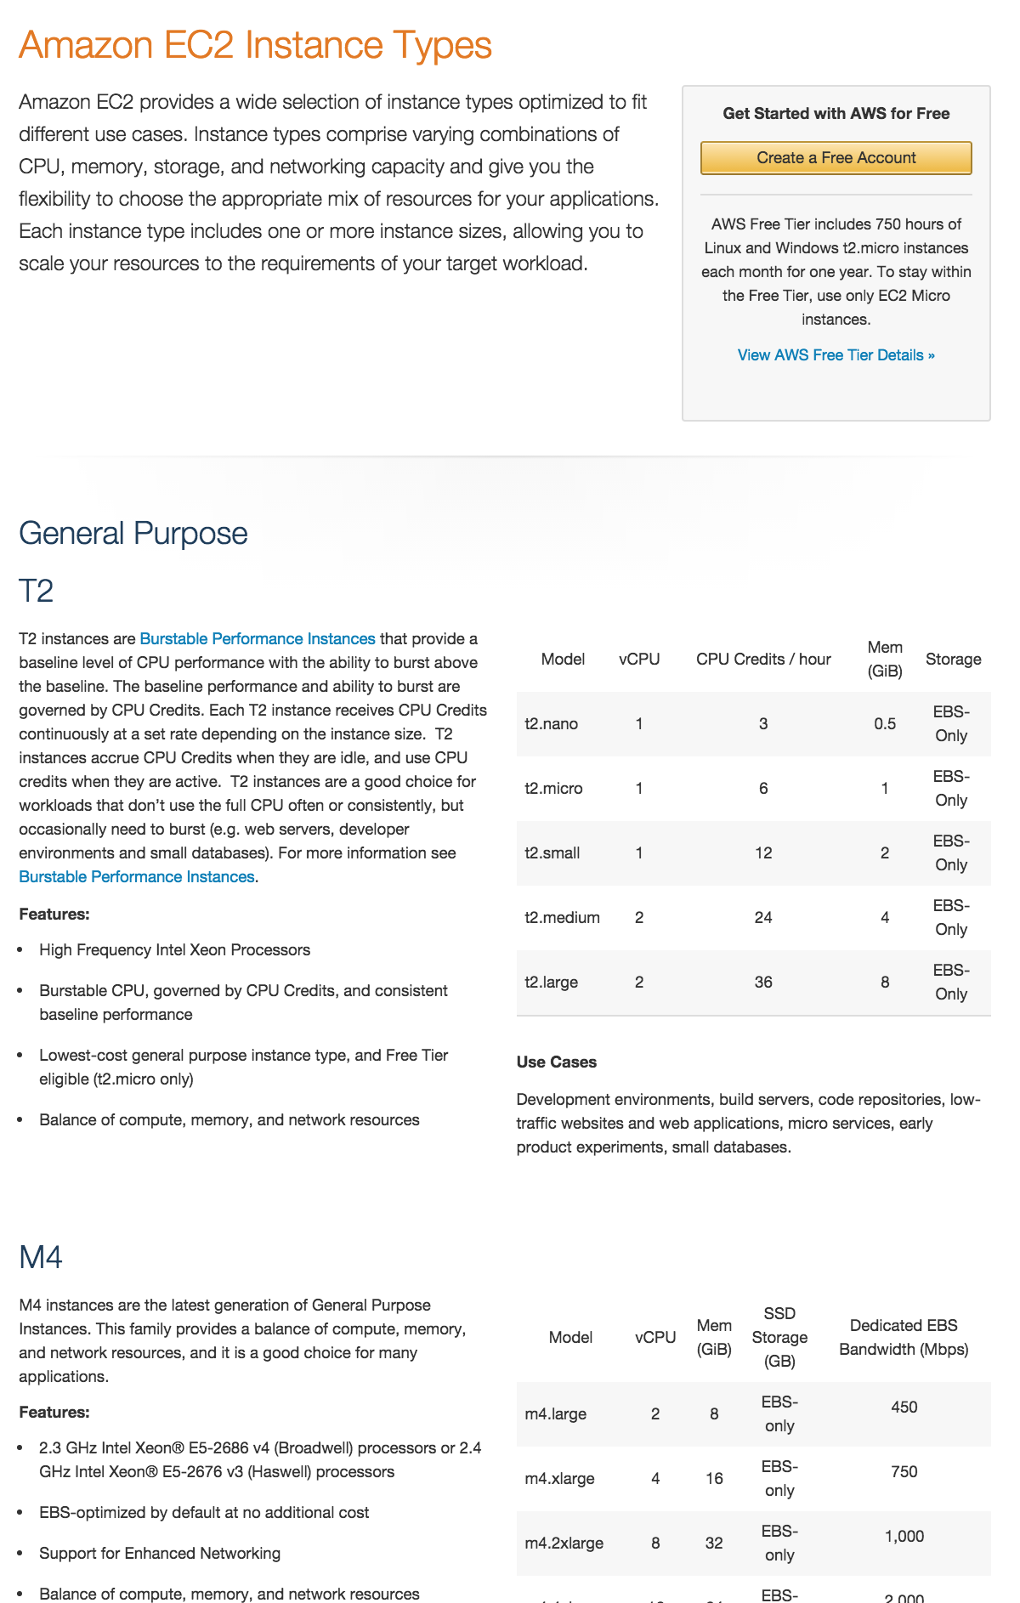

Slide 30
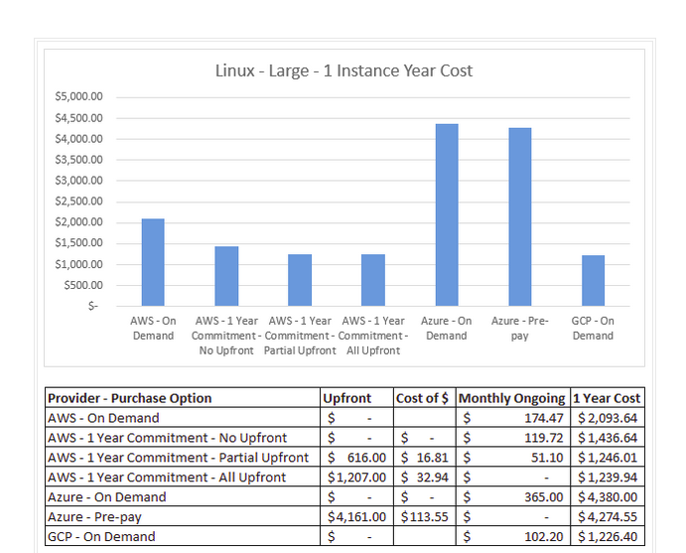

Slide 31
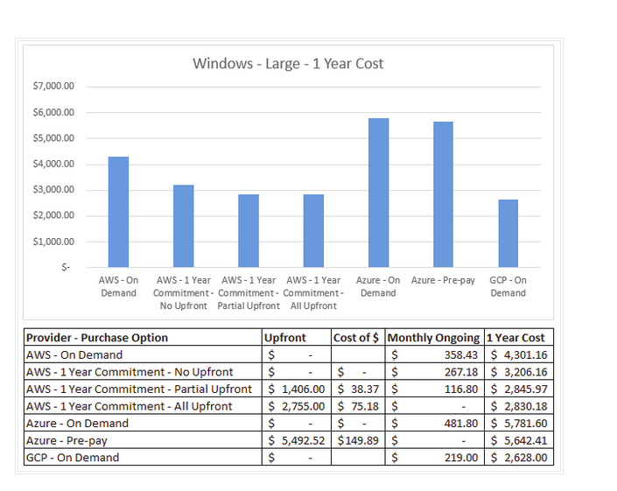

Slide 32
Complimentary Services
CDN
Logging
Monitoring
Search
Cache
Payment

Slide 33
Leading Edge Services
Containers
Data Science/ML/Big Data
Streams
Devices/IoT (Internet of Things)
Serverless

Slide 34
Cloud Computing: Revolutionary Concepts
Infrastructure As Code
Automated Compliance
Disposable, Immutable Infrastructure
Rebuild instead of Update
Speed vs. Risk
Shared Responsibility
Notes:
10/10/16
34
34

Slide 35
Cloud Computing: Accelerators
Open Source
Containers
DevOps
Continuous Integration/Delivery (CI/CD)
Notes:
10/10/16
35
35

Slide 36
Proactive/Adaptive Security
Rebuild with Infrastructure as Code
Enhanced logging and monitoring
Delegated physical security
Unlimited services (DDoS)
Dynamically modify policies
IAM, Key, and certificate management
Notes:
10/10/16
36
36

Slide 37
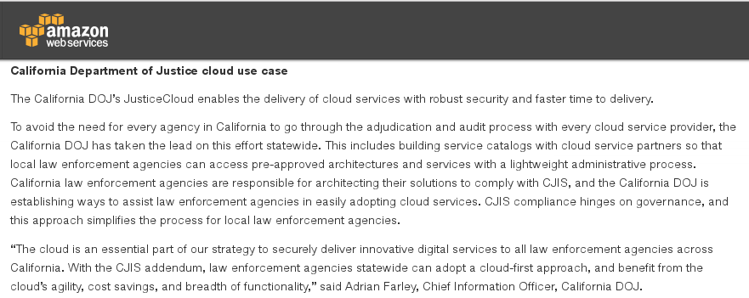
Notes:
10/10/16
37
37

Slide 38
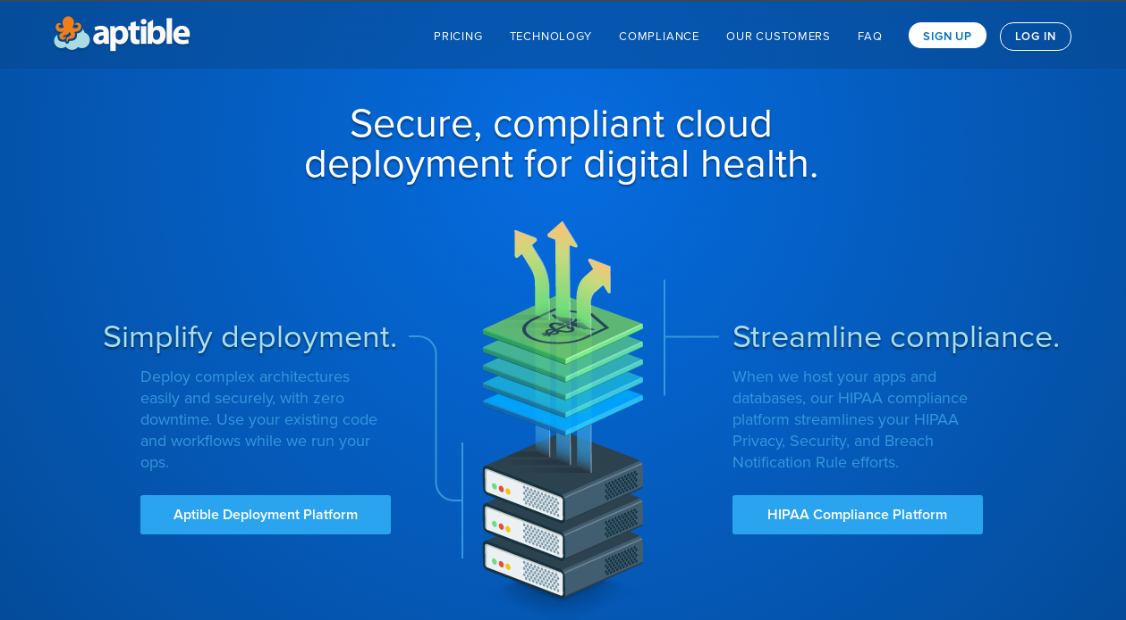
Notes:
10/10/16
38
38

Slide 39
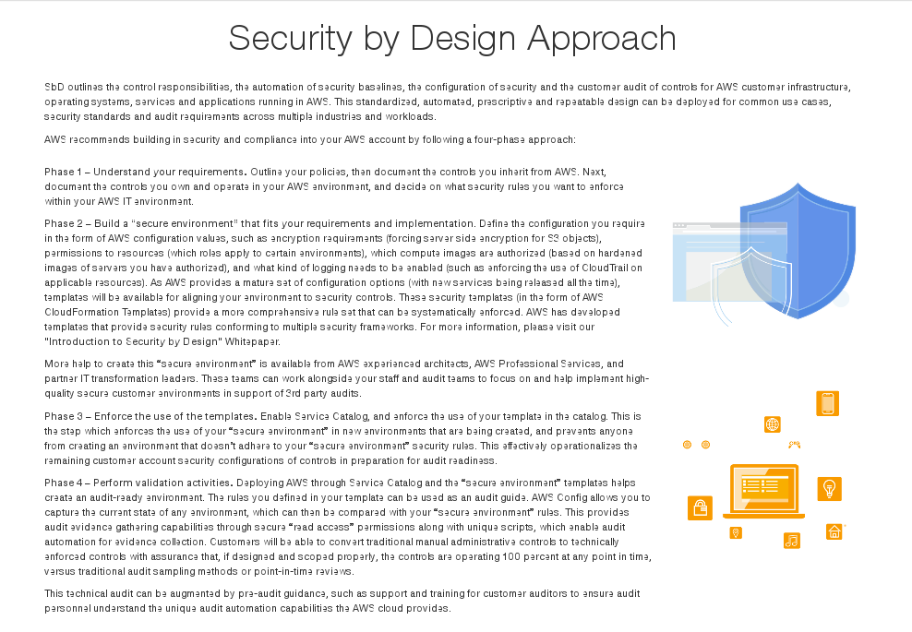
Notes:
10/10/16
39
39

Slide 40
Risk
Delegated, complex security
Access keys
Root account compromise
Notes:
10/10/16
40
40

Slide 41
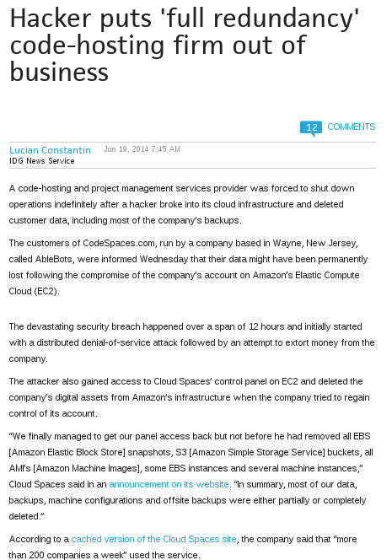
Notes:
10/10/16
41
41

Slide 42
Minimize Risk: AWS
Multiple accounts
Multiple VPCs
Managed, rotated credentials and keys
IAM roles
MFA
Encryption
Monitoring, auditing
Notes:
10/10/16
42
42

Slide 43
PaaS
Heroku
Salesforce (Gov Cloud)
Acquia Cloud
Notes:
10/11/16
43
43

Slide 44
Acquia Cloud PaaS Features
Application Stack: LAMP + Drupal Distribution
Solr Search
Varnish
Git Workflow
Security

Slide 45
SaaS
Office 365
Google Services
Box
Salesforce
Huddle
Notes:
10/11/16
45
45

Slide 46
Service Bundle: AWS
AWS S3 and Aurora
Snowball and Glacier
WAF
Lambda
Alexa App
On-premise AD

Slide 47
Service Bundle: Azure
Azure VMs
Office 365
Azure AD
Azure MFA
Azure Stack

Slide 48
Service Bundle: Google
GCP VMs
BigQuery
Tensorflow
Kubernetes
Google Maps
Google Apps

Slide 49
Service Bundle: Hybrid
AWS EC2
BigQuery
On premise AD
IBM Watson
Office 365
Salesforce API
Acquia Cloud

Slide 50
Cloud Strategies
Assess tradeoffs among SaaS, PaaS, and IaaS
TCO, competitive strengths and expertise
Consider combination
Notes:
10/11/16
50
50

Slide 51
Cross Cloud/Environment Tools
Docker/Containers
Vagrant/Docker Machine
Terraform

Slide 52
Demos
WordPress on Azure Using Azure Resource Manager (ARM)
Drupal on AWS using CloudFormation and Docker
Drupal on Acquia
Notes:
10/10/16
52
52

Slide 53
Azure Resource Manager
ARM Templates
Virtual Machines
Network Components
Public IP NAT/DNS
Database

Slide 54
CloudFormation and Docker
Infrastructure As Code
CloudFormation Templates: resources, parameters, conditions,mappings, Outputs
User Data: Customize instances
Dockerfiles: Application containers, orchestration
Git: Version control

Slide 55
Contact
Email: mnescot@jbsinternational.com
Twitter: @mnescot
Github: github.com/mnescot

